Slide 1
运用机器学习算法预测在线课程用户的成绩以及课程完成度
W. Chen, C. Brinton, D. Cao, M. Chiang. “Early Detection Prediction of Learning Outcomes in Online Short-Courses
via Learning Behaviors.” IEEE Transactions on Learning Technologies, 2017.
W. Chen, C. Brinton, D. Cao and M. Chiang, “Behavior in social learning networks: Early detection for online shortcourses”,
Proc. of IEEE INFOCOM, Atlanta, GA, May 2017.
In this paper, we ask:
Can we use behavior to predict learning outcomes in short-courses?
How early into short-courses can these predictions be made?
Is one type of learning behavior more effective for prediction?

Slide 2
W. Chen, C. Brinton, D. Cao and M. Chiang, “Behavior in social learning networks: Early detection for online short courses”,
Proc. of IEEE INFOCOM, Atlanta, GA, May 2017.
Prediction classifiers. We consider four classifiers for completeness. Given their optimization approaches, they are typically applied to different feature types, and we are using indicator, integer, and continuous features
K-Nearest Neighbor (KNN),
KNN (number of neighbors (k)) are tuned during the cross validation. (how)
Support Vector Machine (SVM):
SVM uses a kernel function to find the optimal hyperplane separation and is typically applied to non-indicator features
3. Linear Discriminant Analysis (LDA)
LDA has been seen to work better on continuous quantities given that it finds a linear combination of the features which best separates groups
Random Forest (RF).
RF is an ensemble tree method applied to any type of feature
Parameters:
SVM: We use the radial basis function (rbf) kernel. The parameters are (kernel standard deviation) and regularization penalty (C)),
RF: number of trees and number of variables, randomly sampled at each tree split.
KNN: (number of neighbors (k)) are tuned during the cross validation. (how)

Slide 3
Metrics.
We primarily consider AUC (i.e., the area under the ROC curve) and Type II error (i.e., fraction of fails that
are incorrectly predicted as passes) , or, (false positives) as evaluation metrics. In practice, we are interested in identifying learners who are at risk of failing in advance so the instructor can be notified; consequently, we would like a classifier to obtain a low Type II error while maintaining a high AUC, so that we correctly identify the fails while not flagging too many passes incorrectly as fails. For completeness, we also report Accuracy (Acc, i.e., fraction of all predictions that are correct).
Cross validation.
For training and evaluation, we repeatedly
(i) divide the dataset randomly into K folds (K = 5) stratified such that each fold has roughly the same proportion of classes.
(ii) train and tune the algorithms through cross validation on K - 1 of the folds, choosing the set of parameters with highest average accuracy,7 and
(iii) evaluate on the holdout fold, similar to the procedure detailed in [1]. The metrics we report are averaged over several (50 ) runs of this procedure, to obtain a general estimate of quality.

Slide 4
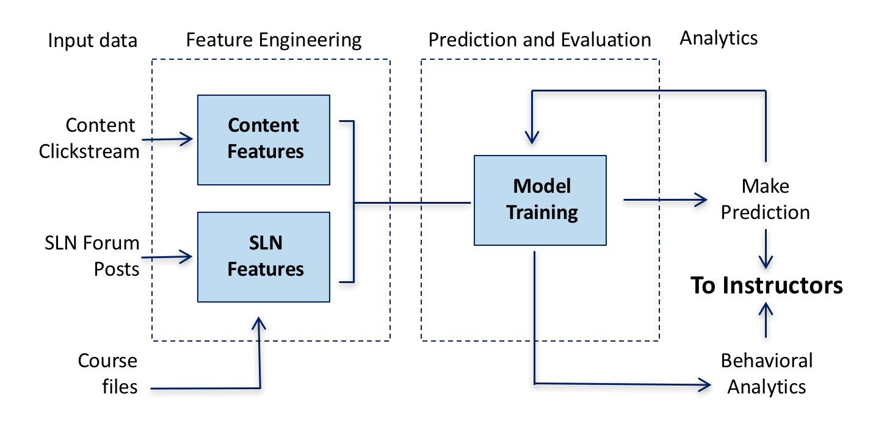
Our Methodology
Here is a block diagram of the process
Notes:
Here is a block diagram of what we do in this paper. This diagram has 4 main parts, starting from the input. The input consists of three different sources, as we mentioned in the system architecture slide 3.
All the input feeds into the second block, feature engineering.
The learner content clickstream, captured in our Player, feeds to the first kind of the feature, content feature.
Whereas the learner-generated social content and the course content, together feeds to become the SLN features.
We will discuss the details of our feature engineering in the next slide.
After that, we have a block of model training and evaluation, which we will discuss proceeding to the feature engineering.
Last but not least, analytics.

Slide 5
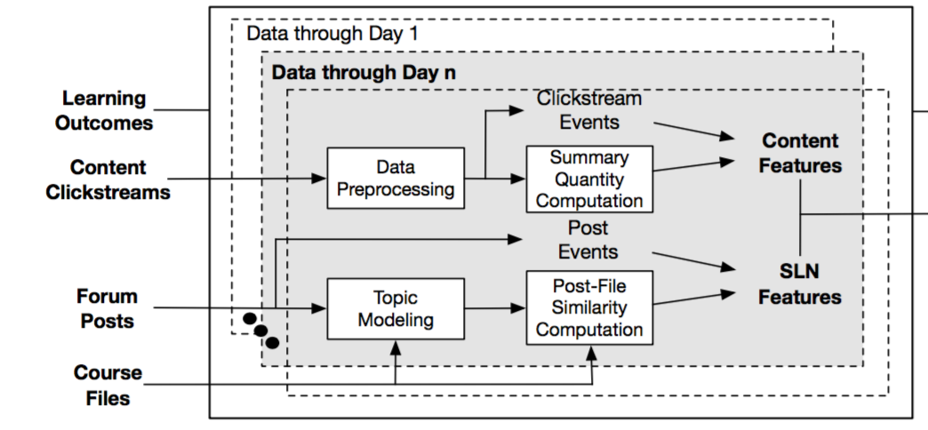
Feature Engineering
SLN Features
Topic Extraction (LDA)
Content Similarity (TVD)
Social Involvement (Volume)
Content Features:
Time Spent
Learner Completion
Engagement
Prediction &
Evaluation
Approximately 400 features in total for each of the course.
Notes:
In our study, we mainly focus on two different types of features. The first type, content feature, generated from learner clickstreams.
The main categories are time spent, how much time learners spent in the course content. Note that we factor our off-task behaviors to make the time spent more precise. For example, if the learner swaps to another application instead of our Player, say Youtube, we want to filter out this period of time.
We also include completion rate, the portion of the content completed, and engagement.
For engagement, we have a specific formula that we created and modified through working with clients, so that the engagement values are important and predictive.
We have around 400 features in total for each of the course, including the three categories at different content level, such as unit-level and module-level.
The second type, SLN feature, generated from learner generated social content and course content.
Three sub-categories as well, the first part, we extract the topics from the course via LDA.
Second, we compare the topics extracted from the course with the content the user generated in the discussion forum via Total Variation Distance. This also echoes an important indicator in educational psychology, of whether learners learn well is to see how they are able to go back and make logical connections and extensions between the topics.
The third type, volume. We measure the activity level for each learner in the discussion forum.

Slide 6
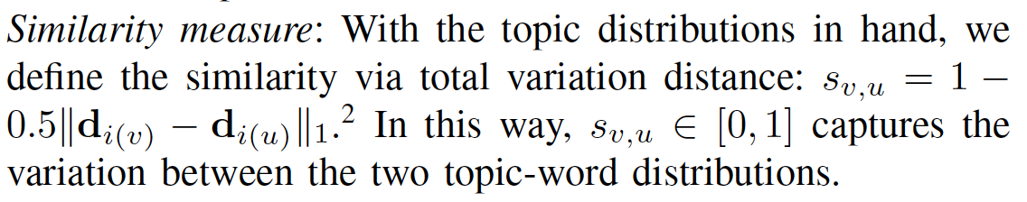
SLN features: replies, votes, posts. And content similarity
Content similarity: Topic Distribution; LDA

Slide 7
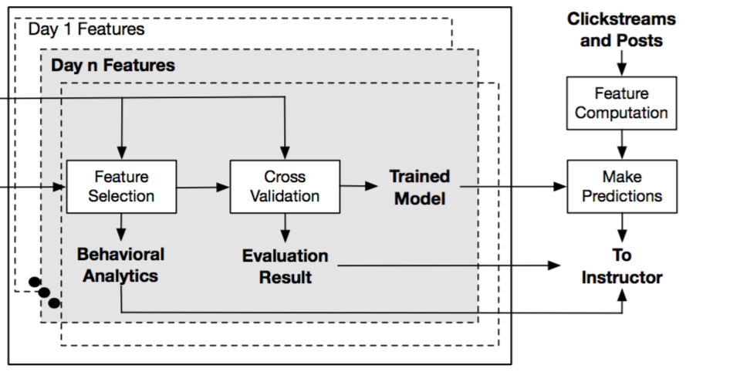
Prediction & Evaluation
Algorithm Choices:
SVM
Random Forest
Linear Discriminant Analysis
K-Nearest Neighbor
Evaluation Metrics
Accuracy
AUC
Type II Error
Learning
Outcomes
Notes:
Go back to slide 5 and quickly introduce.
This is the detailed process of the second half of the block diagram from slide 5.
After we run the engineering processes on the input data, we run feature selection to keep the predictive features for two purposes.
First, we use the remaining features to provide behavioral analytics to instructors. An example would be which part of the course content really plays a role in learner outcome.
Second, we feed these remaining features to train our model.
Obviously, we have cross validation to avoid over fitting. We employ 4 algorithms here, SVM, RF, LDA, KNN. We evaluate our model with three metrics, ACC, AUC, and Type II. Accuracy is straight forward and so is AUC. We consider Type II error important here, the reason as cancer prediction. We do not want to miss identifying patent diagnosed as cancer, in our case, learners at risk. At the end of the day, we are looking for a model that achieves high ACC with minimal Type II error.
KNN and SVM: previously used in the space
RF: entropy-based
LDA: easily interpreted and less parameters to trained

Slide 8
Dataset and Implementation
The following is a description of the data resources in our paper:
Data points generated per user is quite large.
Live events occurred for each of these courses around day 10.
Course Name |  | Days | Units | Enrolled | Pass | Fail | Clickstream | Posts
Vanquishing Toxic Employees | VE | 14 | 11 | 79 | 15 | 64 | 20,126 | 73
Effective Communication Skill | ES | 14 | 11 | 94 | 45 | 49 | 45,380 | 104
Developing Leadership Styles | LS | 14 | 11 | 96 | 44 | 52 | 48,449 | 116
Notes:
Once we have chosen the methods and models to implement, let’s take a look at the data source before we proceed to the result evaluation.
As mentioned before that we deploy our system to corporate training, the sample data used here are used for three corporate courses: Vanquish toxic employees, effective communication skills, developing leadership styles.
All last for 2 weeks with 11 units.
Note that, for these courses, the live event for the social discussion take place around day 10.
All courses have less than 100 users, generating 20k~50k clickstream data. If you average that per user, data points generated per user is quite large.
Learners also generate around 100 social posts per course.
Last but not least, all three courses have a larger portion of learners failed than learners passed, especially in course VE, with only approximately 20% success rate. Such imbalance does affect the prediction quality for course VE for the very beginning but will improve significantly with data populating in and stratified cross validation.

Slide 9
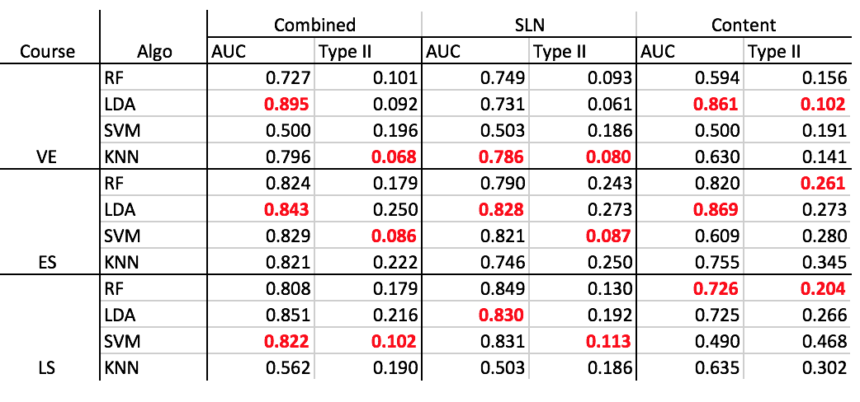
Evaluation: End-of-course Prediction
Behavioral data (no performance) can be used for prediction.
SLN features are more useful than content features by the end.
Notes:
Again, we want to build a classifier that identifies learners at risk of failing. Here we have a table summarizing the prediction quality for three courses and four chosen algorithms.
The bold part of the table highlights the algorithm with good qualities.
Particularly, we divide the source of the dataset to three: content, SLN, and combination of both.
This goes back to the first research question we asked in slide 2: can we use learner behavior to predict. And the answer to that is yes, we definitely can. Note that, in this research we did not use any learner performance data, since that is something not available to us. But we still achieve an average prediction quality around 85% AUC. Especially, recall course VE with the significantly imbalanced dataset, we still achieve around 90% AUC with LDA.

Slide 10
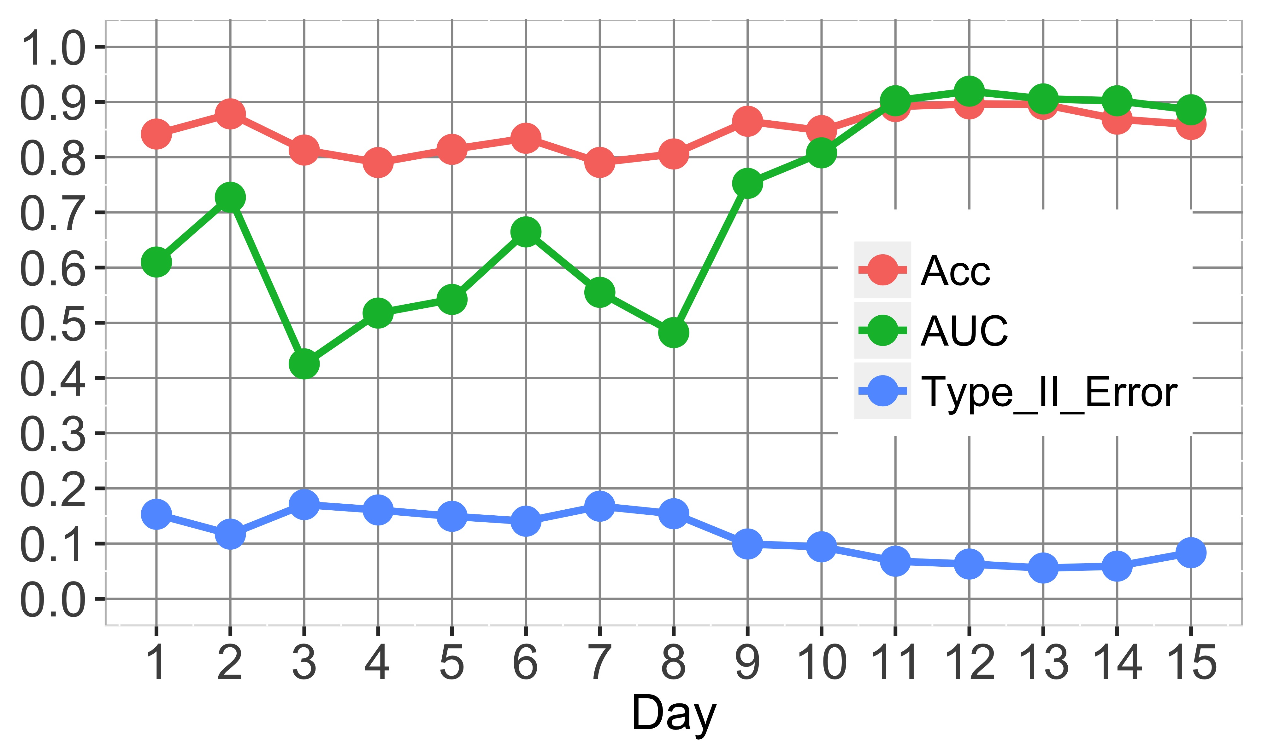
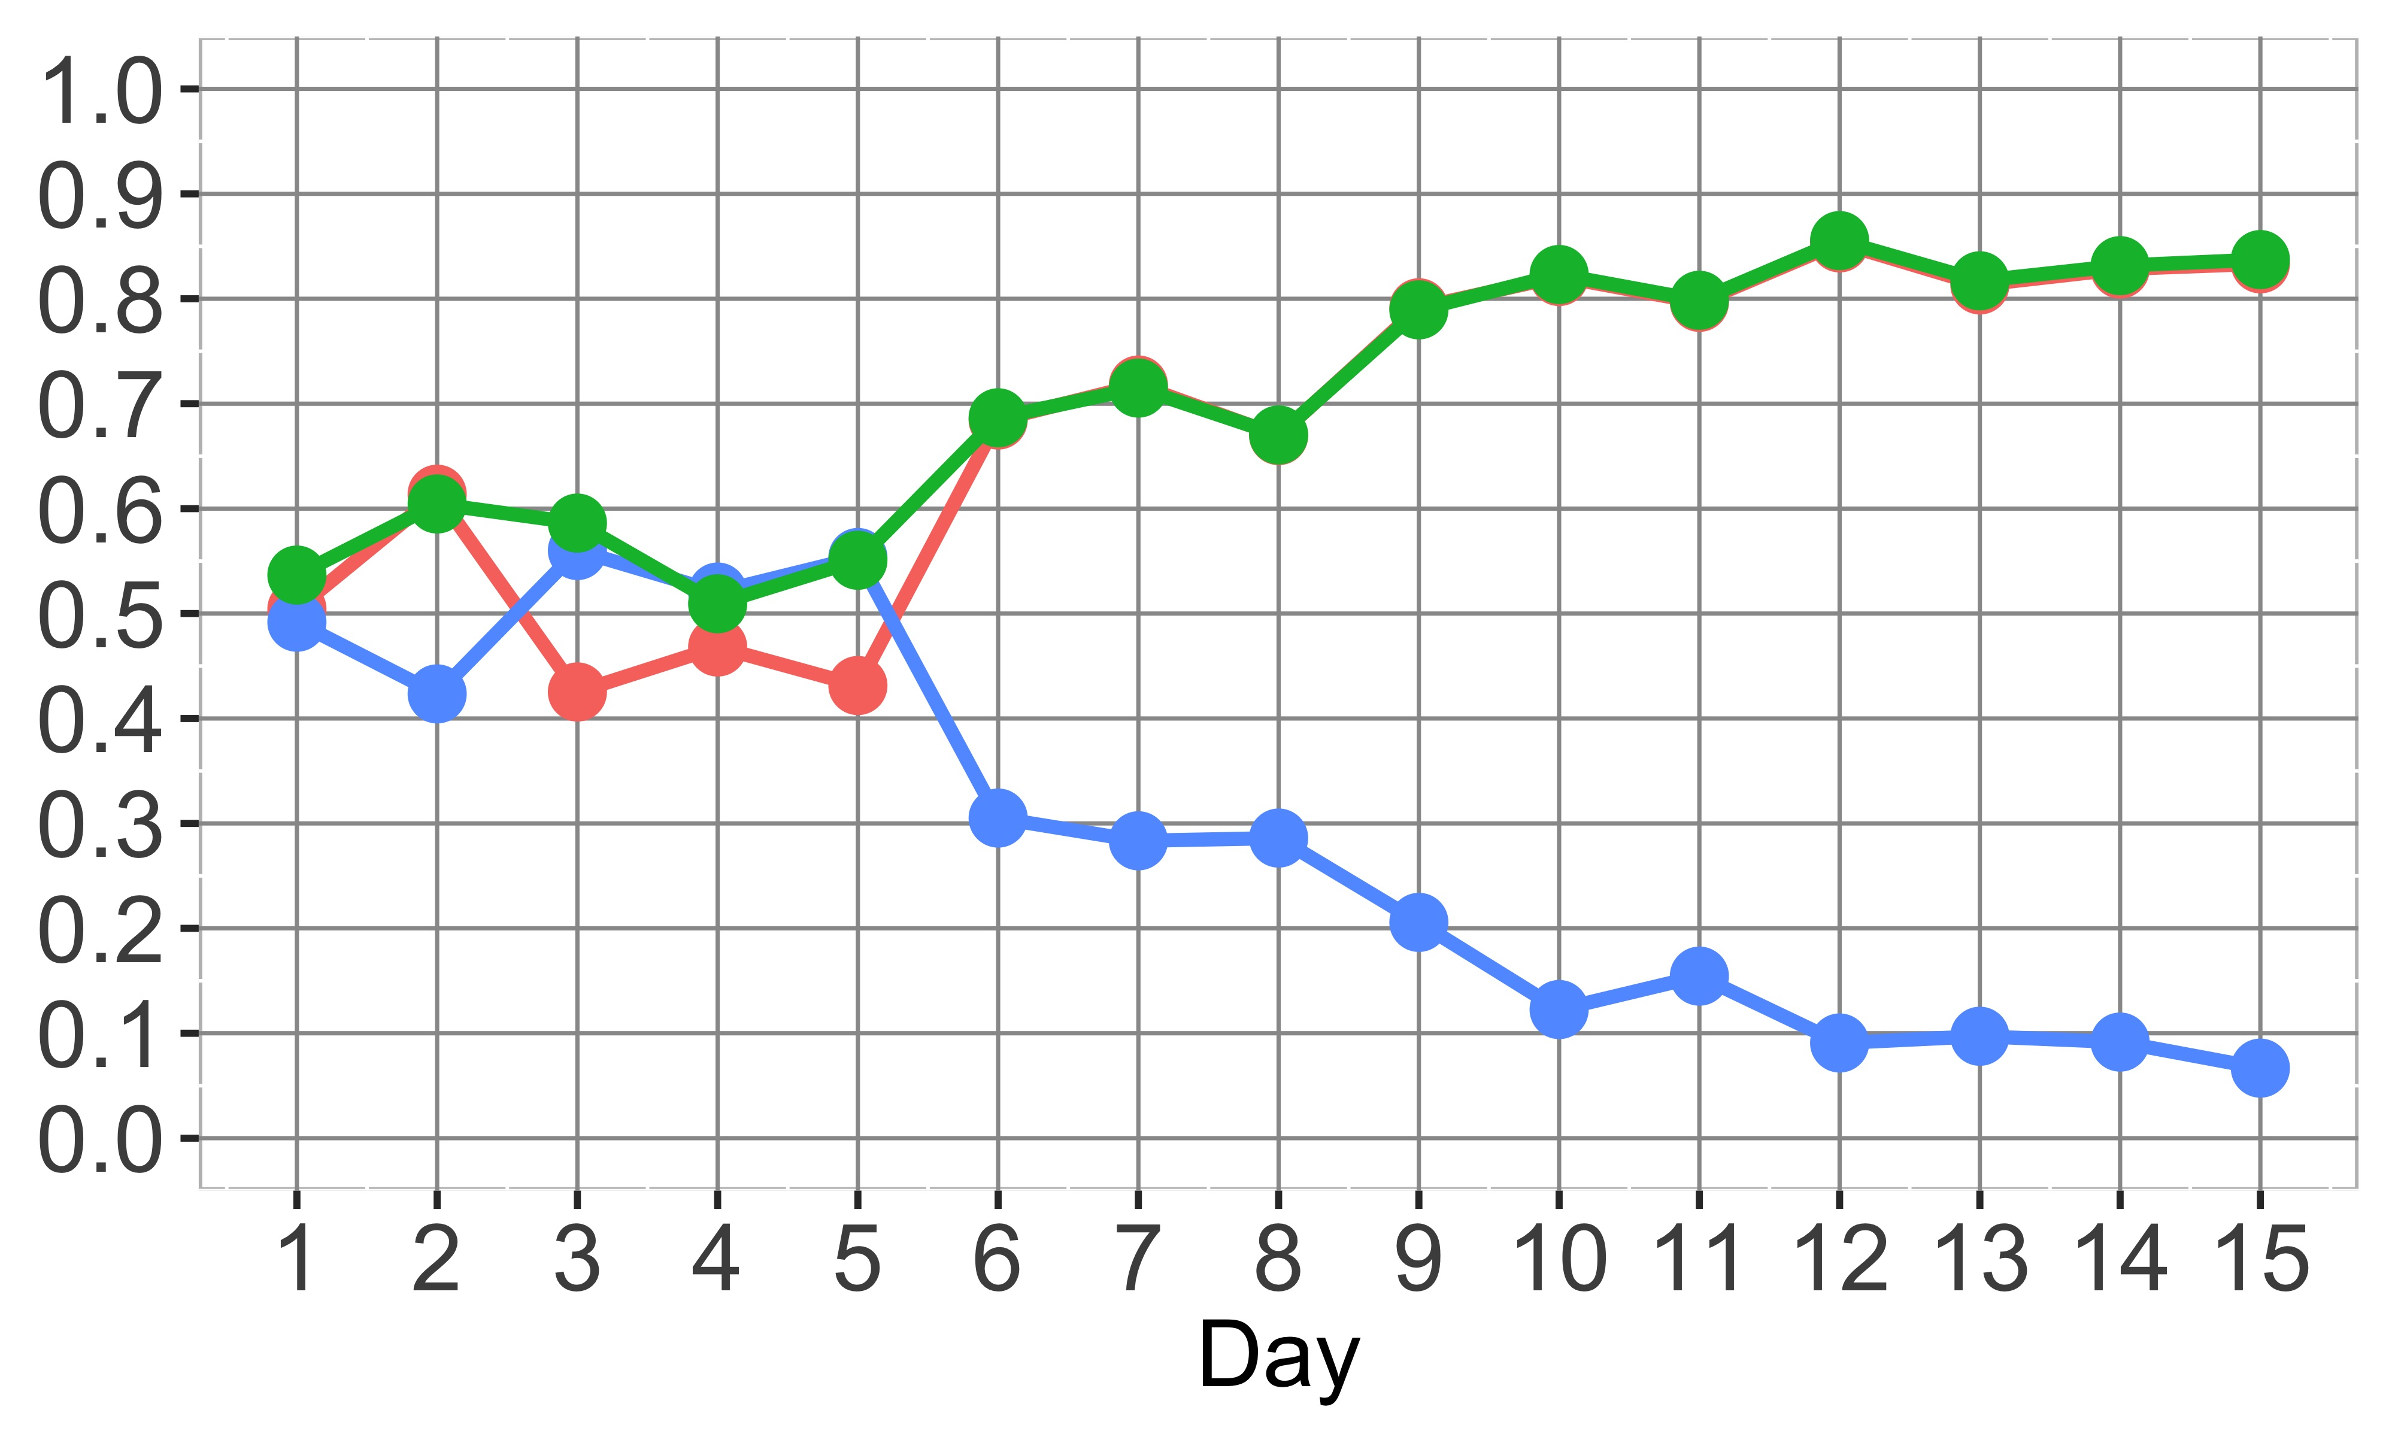
Day-by-day Prediction
Variation in prediction quality by day for course VE and ES, using the full feature set:
Behavior-based prediction has an early detection capability. The AUCs reach 70% by day 7, which shows that behavioral features can be used for early detection.
LDA applied to VE
SVM applied to ES
Notes:
Once we have the classifier built, we then ask ourselves the second question: how early can we predict? The reason is that we want to be able to identify these learners and provide early help to improve learning success.
Here what we did is to use the learner data, generated on daily basis, to make the prediction on specific dates. For example, we train on day 3 data and make predictions on day 3, hoping that we can identify learners with patterns at risk as early as possible. Here are the plots demonstrating the prediction quality varying day by day for VE and ES, using both content and SLN features.
We see that, behavior-based prediction has an early detection capability. The AUCs reach 70% by day 7, which shows that behavioral features can be used for early detection.

Slide 11
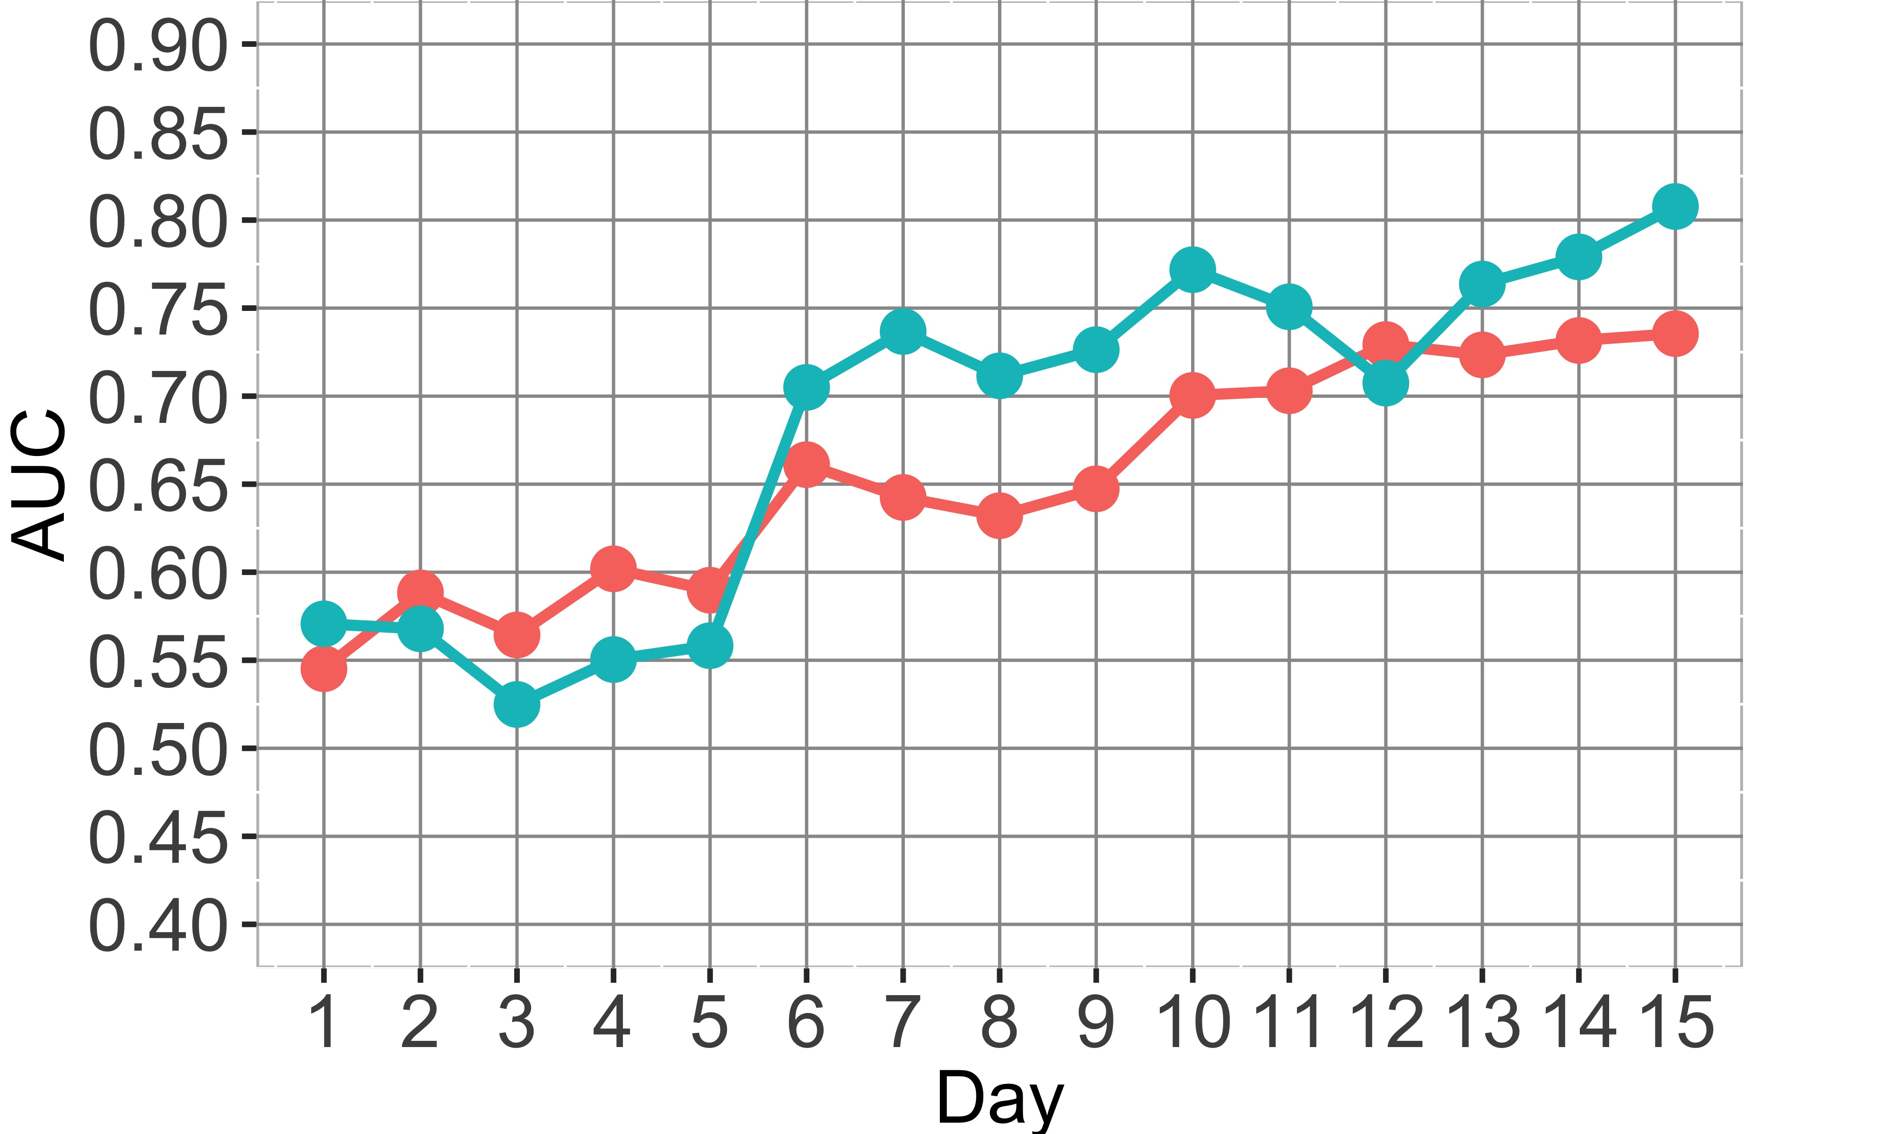
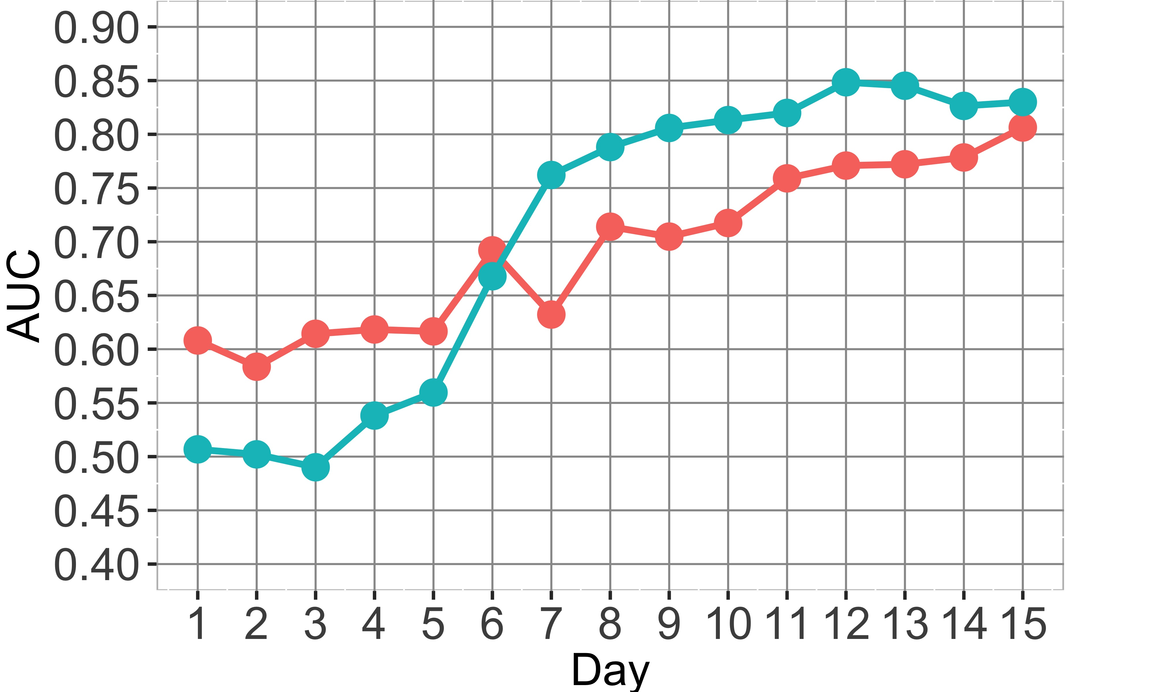
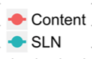
Feature-type Comparison
Variation in prediction quality by day for each course, using the content and SLN features:
In ES and LS, the SLN features have higher quality later.
For “earliest” detection, content features have an advantage.
Course ES
Course LS
Notes:
Now we address the first two of the research questions we asked, we come to the third one: in one type of learning behavior more effective for prediction?
Recall to the feature engineering slide, we divide our features to two types: content and SLN. Now previously we use the combination of both features to predict. In here we want to compare if any of the type is preferred. The plots demonstrate variation in prediction quality by day for each course. We see that:
In ES and LS, the SLN features have higher quality later.
For “earliest” detection, content features have an advantage.

Slide 12
运用凸优化理论建造并且优化基于论坛的社交学习网络模型
Optimized networks have up to 30% improvements in learning “utility”
Gives recommendations of new interactions

Slide 13
Social Learning Networks (NM)
SLN: People exchanging information on educational topics through structured interactions
Online education, online training, Q&A sites, …
Enterprise Social Networks (ESN): Jive, Yammer, even Hipchat, …
Driving research questions:
How to model and visualize an SLN, and how to quantify efficiency?
How to make SLN more effective through recommendations?

Slide 14
Social Learning Networks (NM)
Block diagram of major components:
Inference and optimization algorithms:
Network Inference: Probabilistic message-passing
Topic extraction: Latent Dirichlet Allocation (LDA)
Parameter estimation: Seeking and Disseminating Tendencies
Observed SLN
SLN
Discussions
Network
Identification
Evaluate &
Recommend
Topic
Extraction
Parameter
Estimation
Network
Optimization
Ideal SLN

Slide 15
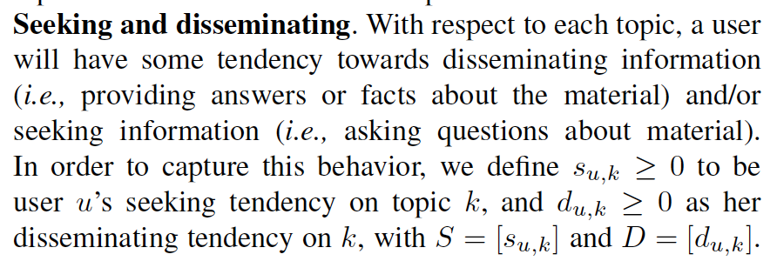
Define:
Optimize interaction communities
Seeking and disseminating tendencies
Tradeoff local and global utilities
Optimized networks have up to 30% improvements in learning “utility”
Gives recommendations of new interactions

Slide 16
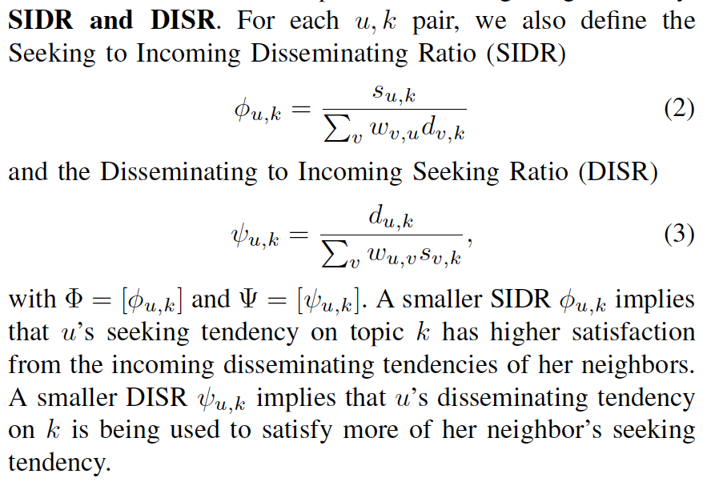
Define :

Slide 17
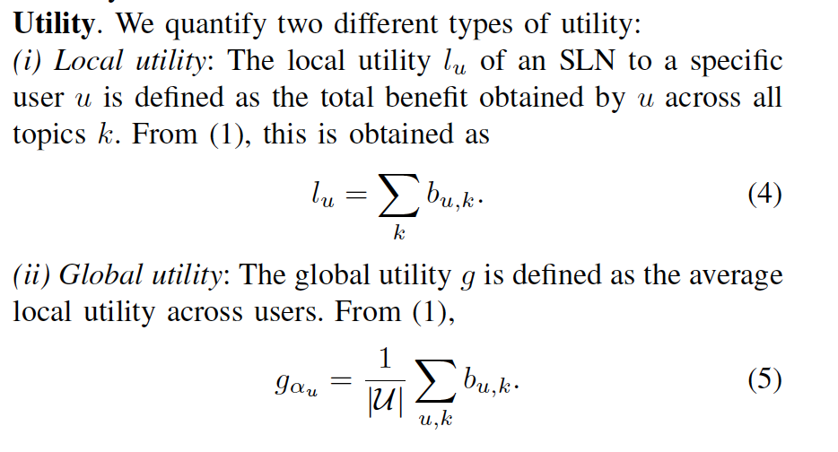
Define Utility:

Slide 18
Social Learning Networks (NM)
Global utility with deficit penalty
maximize
Seeking tendency
satisfaction
subject to
Participation
capacity
Gradient
Step
variables
Quadratic
Program
Projection
Step
This (convex) optimization is big
Millions of variables for 1K users
Derived and implemented PGD algorithm
Objective
Step

Slide 19
Engagement as a Predictor (SL)
Our engagement score is predictive of learning outcomes
Some example regressors for an Accenture course:
Engaging 50% more with slide 30 (module summary) was associated
with an improvement in exam score by 17.2%
Those who engaged 50% more with slide 15 “1.7 Residential
Establishments” had a drop in Q/FPT by -3.70%
Engaging 20% more with slide 74 “3.3(a) The Mortgage Life Cycle:
Servicing” corresponded to a drop in Q/FPT by -3.31%
Engaging by 50% more with slide 90 “3.9 Module Summary”
corresponded to a drop in discussion score by -3.35

Slide 20
Motifs as Predictors (SL)
Our motifs are also predictive:
1. Read 1 ~ 8 sec
5
6
7
8
9
10
11
2. Skip back 1 or 2 slides
Performing the sequential actions of (i) spending 1-8 seconds on a slide followed by (ii) skipping back 1-2 slides ten more times will improve the score on the post-test by +5.3%.
1. Read more than 25 sec
3. Read 10 to 25 sec
22
23
24
29
30
31
32
2. Skip forward 5 to 15 slides
Performing the sequential skimming actions of (i) spending more than 25 seconds on a slide, followed by (ii) skipping forward 5-15 slides, followed by (iii) spending 10-25 seconds on a slide five more times will lower performance on the exam by -33.9%.

Slide 21
Regression – Implementation
Regression: a statistical measure used to determine the strength of relationship between dependent variable (can be user performance, operational data, and etc.) and a series of other changing variables (in our case, user behaviors)
To implement in Dashboard:
Dashboard Features
Feature Pre-processing
Our Algorithm
Estimated Improvement
User Behavior
(not Motif)
Interaction of Features
Confidence Level
User Perfor-mance
Summing and Subtraction

Slide 22
Regression – An Example
Feature 1 | Feature 2 | Coefficient | Estimated Improvement | Confidence Level
X53_time_spent | Re2.Sf1 | -0.47998281 | -1.53149628 | 3.905698e-02
X2_num_views | N/A | 0.11304060 | 0.11304060 | 1.698015e-09
X1_abs_eng | N/A | -0.40392338 | -0.04039234 | 9.735695e-09
Output Message Examples
(1). By spending extra minute on X53 and doing extra interaction on Re2.Sf1 , we expect a change of -1.53 on post-test performance.
(2). By doing extra interaction on X2 and doing extra interaction on X2 , we expect a change of 0.11 on post-test performance
(3). By engaging 10% more on X1 and engaging 10% more on X1 , we expect a change of -0.04 on post-test performance

Slide 23
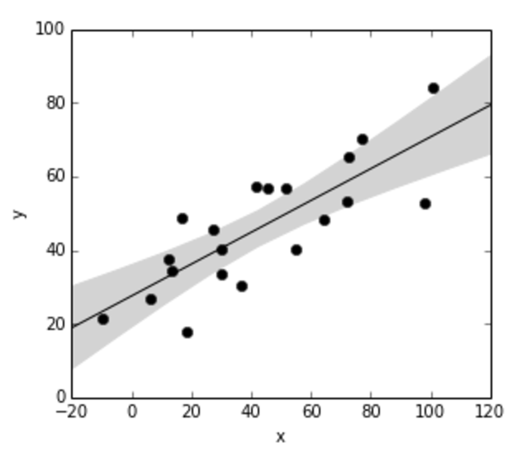
Regression – Confidence Level
One important feature we add to this regression technique is that, we compute a confidence level (p-value) by employing a Bayesian technique.
The Bayesian technique essentially
outputs not one single number for the
coefficient, but rather a distribution of
the coefficient, allowing us to compute
a confidence level of the improvement,
i.e., a p-value.

Slide 24
Regression – Interaction Between Features
Another feature we add into the regression technique, is that we can now look at the interaction of features.
In our example, X53_time_spent and Re2.Sf1 together have an interacted coefficient of -0.47998281.
Because our regression algorithm is multivariate, we can now also sum or subtract the coefficients to achieve a combination result. This allows us to propose a study plan to optimize general user learning experience.
1. Read 10 to 25 sec
35
40
45
50
55
50
32
2. Skip forward 5 to 15 slides
3. Spend extra minute on X53

Slide 25
Regression - Continued
Most of the features are already developed within the Dashboard, except the Motif. The algorithm itself is thus easy to implement.
We use Lasso Regularization to control over-fitting, as we have smaller datasets that are prone to such issues. Moreover, such technique has a sparse output of coefficients (good for feature extraction).
Nonetheless, the algorithm is relatively computational expensive compared to linear regression.
We also need to be cautious about how we interpret the results; we don’t want to imply causal relationships
Next step: Improve time efficiency by customized scaling method and standard error method

Slide 26
Identifying Behavioral Motifs (SPM)
Sequence representation: Event-based
Each action becomes Event + Length (or Duration)
Play and Pause: Insert in-between other events to capture state
Motif extraction: Use probabilistic mixture model
Each subsequence assumed to be generated either by position-dependent motif model or position-independent background model
Expectation-maximization (EM) of likelihood given datasets
Example motif of length 4:
Pl2 Sf2 Pl3 Pa4 Sb1
[Pl2 Pl3] Pa1 * [Sf1 Sf2 Sf4]

Slide 27
Identifying Behavioral Motifs (SPM)
Logistic mixed-effects modeling
Fixed effects: Frequency of each motif
Random effects: IDs of each user and video
Group | Interpretation | Sample |  | Δc(%) | p-value
Reflecting | Short to medium-long plays interspersed with short to long pauses | [Pl1 Pl3] Pa4 Pl2 Pa3 [Pl2 Pl1] | FMB | +4.89 | 0.013*
 |  | Pl1 Pa1 Pl1 Pa1 Pl1 Pa1 | NI | -5.29 | 0.036*
Reviewing | Playing for a length, and reviewing some or all of the content | Sb3 [Pl2 Pl1] [Sb2 Sb3] Pl2 Sb2 | FMB | +7.52 | 0.0068**
 |  | Sb2 [Pl2 Pl1] Sb2 Pl2 Sb2 | NI | +9.63 | 0.0078**
Skimming | Long skips forward with short to medium plays in-between | [Pl2 Pl1] [Sf2 Sf3] Pl1 [Sf3 Sf2] | FMB | -4.75 | 0.0096**
 |  | [Pl3 Pl1] [Sf3 Sf4] [Pl1 Pl2] [Sf4 Sf3] [Pl1 Pl2] | NI | +6.45 | 0.085.
Speeding | Viewing at faster than default, slowing down for important content | Rf Rd [Pl1 Pl2] Rf Pl3 | FMB | +9.30 | 0.039*
 |  | [Pl1 Rd] Rf Pl1 Rf Rd | NI | -10.8 | 0.016*

Slide 28
Identifying Behavioral Motifs (SPM)
Reflecting
Reviewing
Skimming
Speeding
Lengths are important to include in frameworks
Reviewing and skimming cannot be identified without them
Correlations dispel ambiguity around effective behaviors
E.g., revising: reinforcement or confusion? (usually the former)
But this varies from course to course

Slide 29
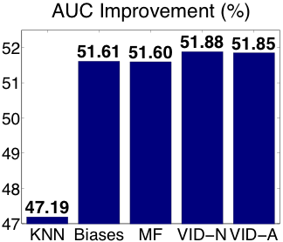
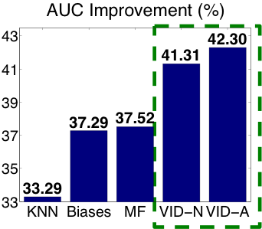
Behavior-Based Outcome Prediction
Representing clickstream behavior
Aggregate quantities: Completion rate, time spent, engagement, ...
Sequences of events, lengths/durations, and/or positions
Early detection of outcomes from behavior
E.g., 85% AUC in predicting P/F within first ten days
Massive Open Online Courses
Corporate Training
Full course
First two weeks
INFOCOM 2015
INFOCOM 2017

Slide 30
Behavior for Content Analytics
1. Read more than 25 sec
3. Read 10 to 25 sec
22
23
24
29
30
31
32
Performing the sequential skimming actions of (i) spending more than 25 seconds on a slide, followed by (ii) skipping forward 5-15 slides, followed by (iii) spending 10-25 seconds on a slide five more times will lower performance on the exam by -33.9%.
2. Skip forward 5 to 15 slides
1. Read 1 to 10 sec
65
66
67
70
71
72
73
2. Skip forward 5 to 15 slides
Performing the sequential actions in the Mortgage Life Cycle module (slides 65-90) of (i) spending 1-10 seconds on a slide followed by (ii) skipping forward 5-15 slides five more times will improve the chance of success on Q17 by +3.0%.

Slide 31
实现 MEME算法， 从用户原始行为序列中辨认与用户类型／特征 学习方式 相关的基序列
Implemented a Multiple EM for Motif Elicitation algorithm for identifying motifs in user behavior sequences.

Slide 32
D. Cao, A.Lan, W.Chen, C. Brinton, M. Chiang, “Learner Behavioral Feature Refinement and Augmentation using GANs”, manuscript submitted for conference

Slide 33
W.Chen, A.Lan, D. Cao, C. Brinton, M. Chiang, “Behavioral Analysis at Scale: Learning Course Prerequisite Structures from Learner Clickstreams”. manuscript submitted for conference

Slide 34
工作中常用的机器学习算法：
1. Matrix factorization
2. SVM : with kernels
3. Random Forest
4. Linear vs logistic regression
5. Bayesian
6. …
深度学习算法：
GAN
CNN
RNN

Slide 35
SVM: 步骤和公式和kernels
We use the radial basis function (rbf) kernel. The parameters are (kernel standard deviation) and regularization penalty (C)),
FUCKING KERNELS

Slide 36
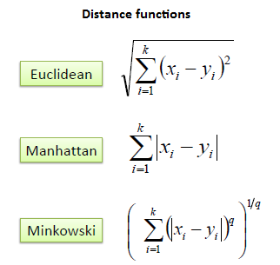
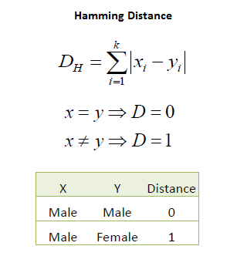
KNN: 步骤和公式
K Nearest Neighbors - Classification
K nearest neighbors is a simple algorithm that stores all available cases and classifies new cases based on a similarity measure (e.g., distance functions).
A case is classified by a majority vote of its neighbors, with the case being assigned to the class most common amongst its K nearest neighbors measured by a distance function. If K = 1, then the case is simply assigned to the class of its nearest neighbor.
It should also be noted that all three distance measures are only valid for continuous variables. In the instance of categorical variables the Hamming distance must be used. It also brings up the issue of standardization of the numerical variables between 0 and 1 when there is a mixture of numerical and categorical variables in the dataset

Slide 37
http://www.saedsayad.com/k_nearest_neighbors.htm
KNN: 步骤和公式
Choosing the optimal value for K is best done by first inspecting the data. In general, a large K value is more precise as it reduces the overall noise but there is no guarantee. Cross-validation is another way to retrospectively determine a good K value by using an independent dataset to validate the K value. Historically, the optimal K for most datasets has been between 3-10. That produces much better results than 1NN.
Notes:
http://www.saedsayad.com/k_nearest_neighbors.htm

Slide 38
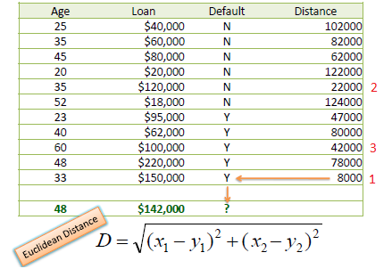
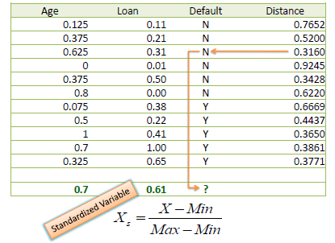
KNN: 步骤和公式
Standardized Distance
One major drawback in calculating distance measures directly from the training set is in the case where variables have different measurement scales or there is a mixture of numerical and categorical variables. For example, if one variable is based on annual income in dollars, and the other is based on age in years then income will have a much higher influence on the distance calculated. One solution is to standardize the training set as shown below

Slide 39
LDA: 步骤和公式
Linear Discriminant Analysis (LDA) is most commonly used as dimensionality reduction technique in the pre-processing step for pattern-classification and machine learning applications. The goal is to project a dataset onto a lower-dimensional space with good class-separability in order avoid overfitting (“curse of dimensionality”) and also reduce computational costs.

Slide 40
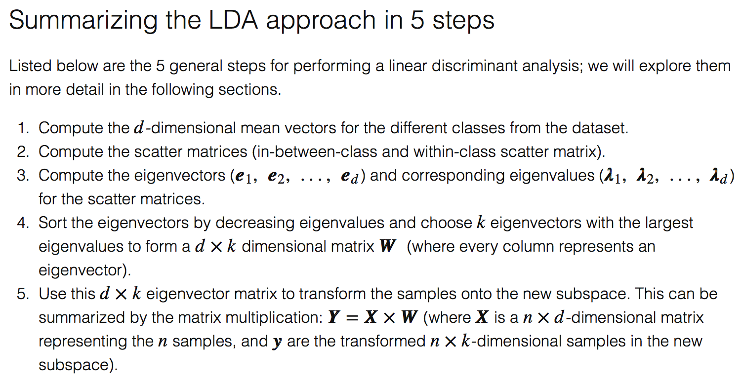
LDA: 步骤和公式

Slide 41
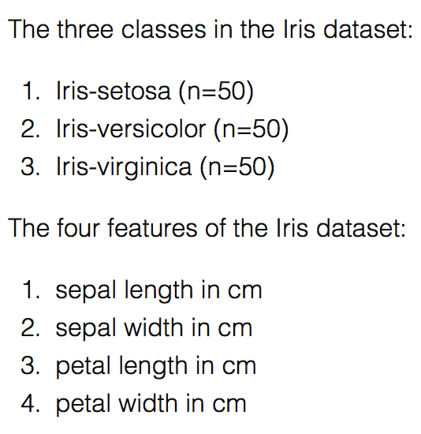
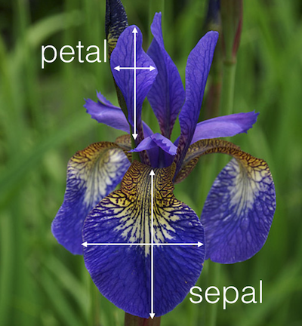
LDA: 步骤和公式 example:

Slide 42
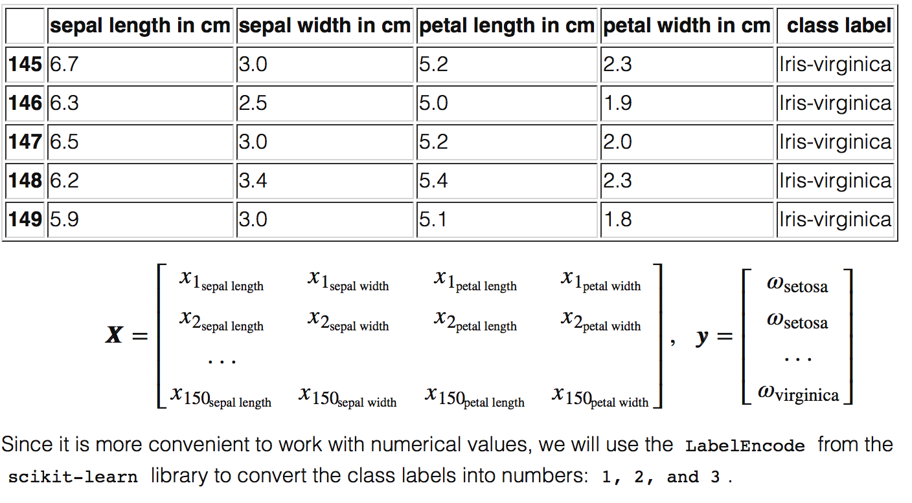
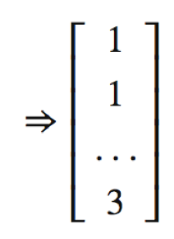
LDA: 步骤和公式 example:

Slide 43
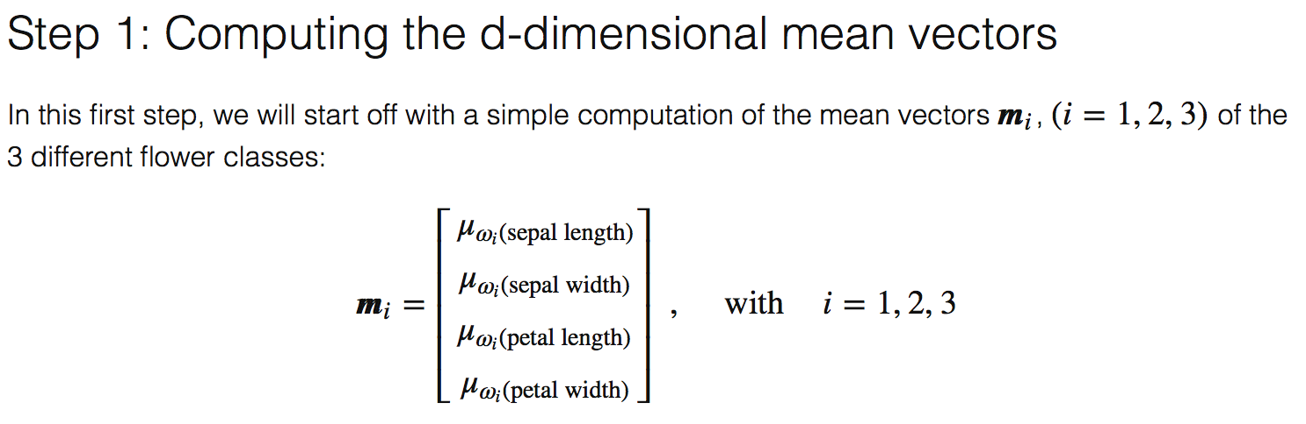
LDA: 步骤和公式 example:

Slide 44
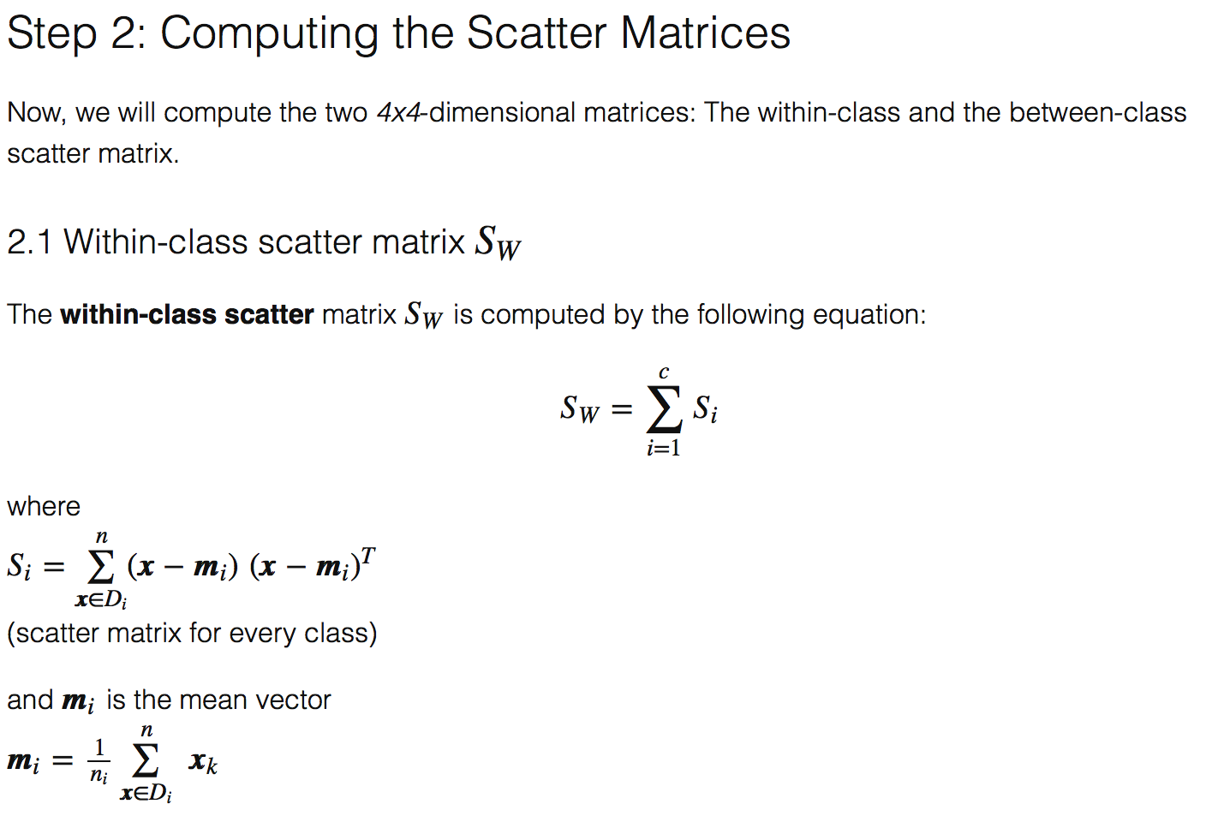
LDA: 步骤和公式 example:

Slide 45
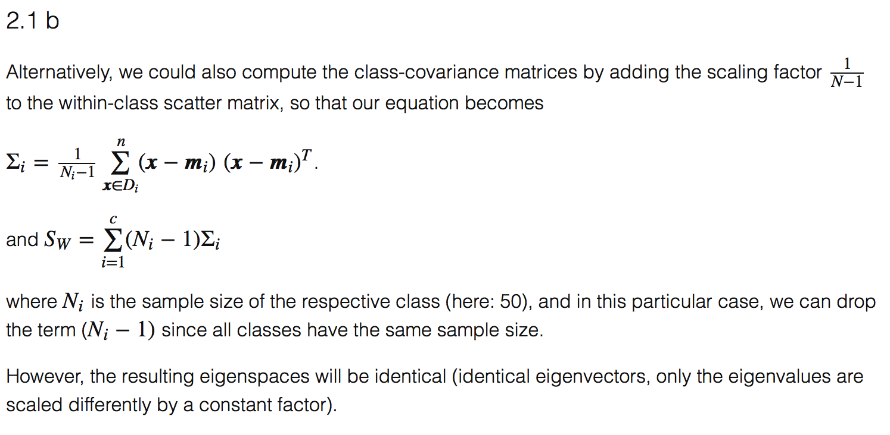
LDA: 步骤和公式 example:

Slide 46
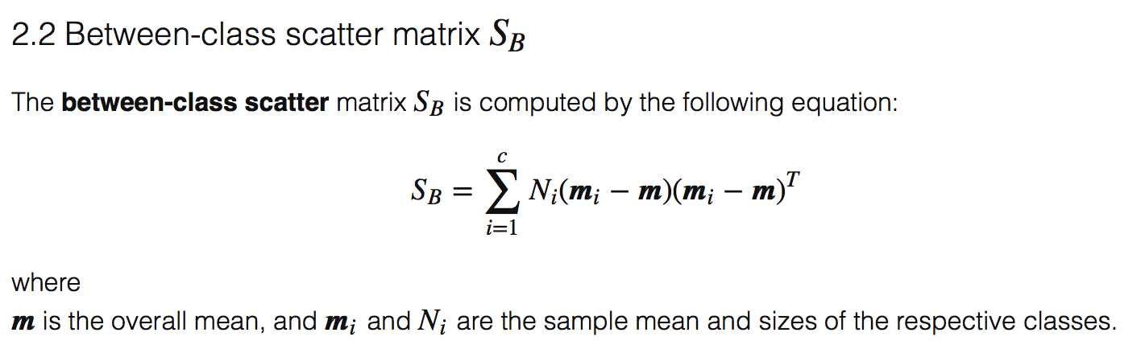
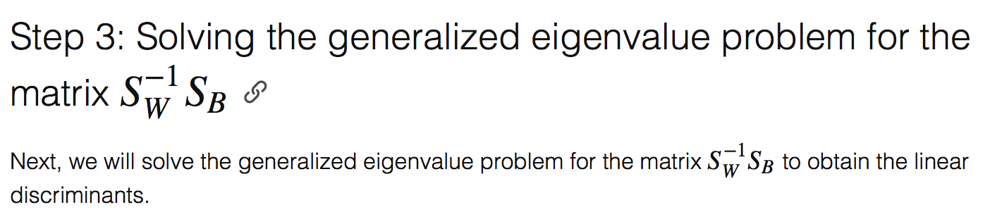
LDA: 步骤和公式 example:
The remaning Step 4 and 5 are easy…

Slide 47
LDA: 步骤和公式
Compared to PCA:
In addition to finding the component axes that maximize the variance of our data (PCA), we are additionally interested in the axes that maximize the separation between multiple classes (LDA).
So, in a nutshell, often the goal of an LDA is to project a feature space (a dataset n-dimensional samples) onto a smaller subspace kk (where k≤n−1k≤n−1) while maintaining the class-discriminatory information. In general, dimensionality reduction does not only help reducing computational costs for a given classification task, but it can also be helpful to avoid overfitting by minimizing the error in parameter estimation (“curse of dimensionality”).

Slide 48
PCA vs LDA
Both are linear transformation techniques for dimensionality reduction.
PCA : “unsupervised” algorithm. It “ignores” class labels and its goal is to find the directions (the so-called principal components) that maximize the variance in a dataset.
LDA: “supervised” and computes the directions (“linear discriminants”) that will represent the axes that that maximize the separation between multiple classes.

Slide 49
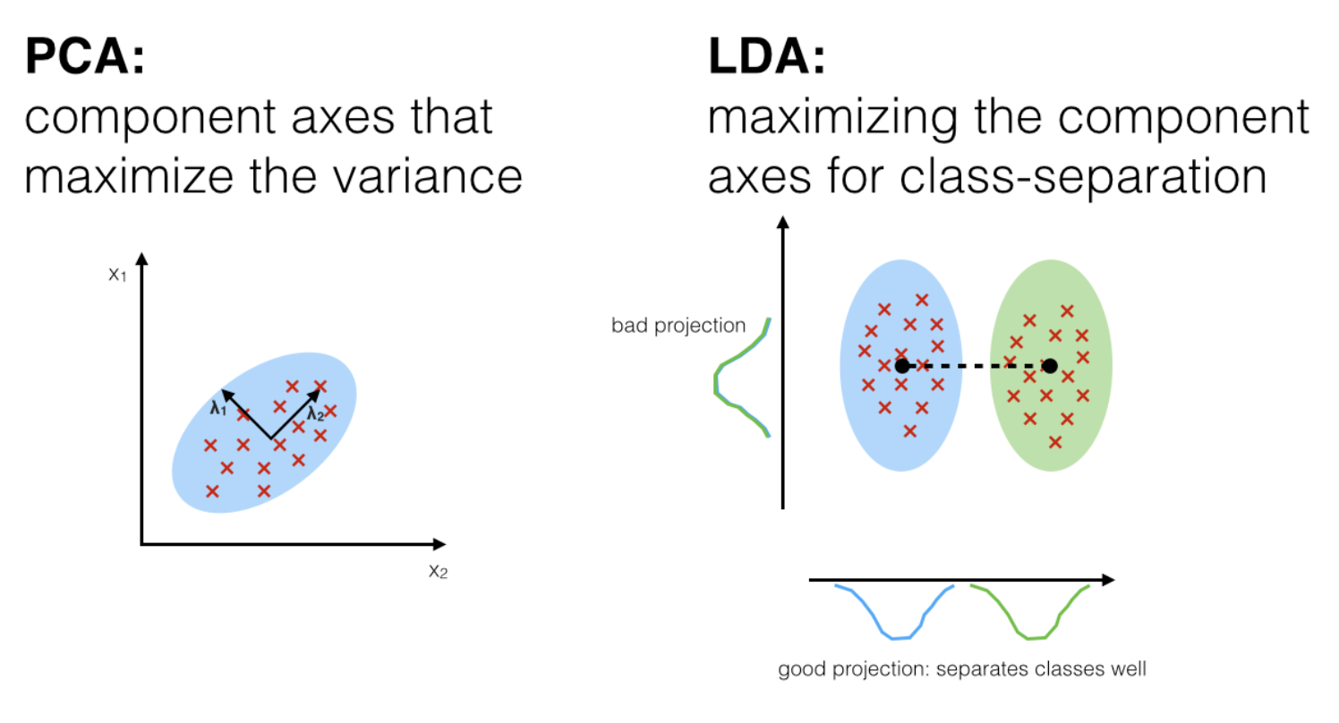
https://sebastianraschka.com/Articles/2014_python_lda.html#introduction
PCA vs LDA

Slide 50
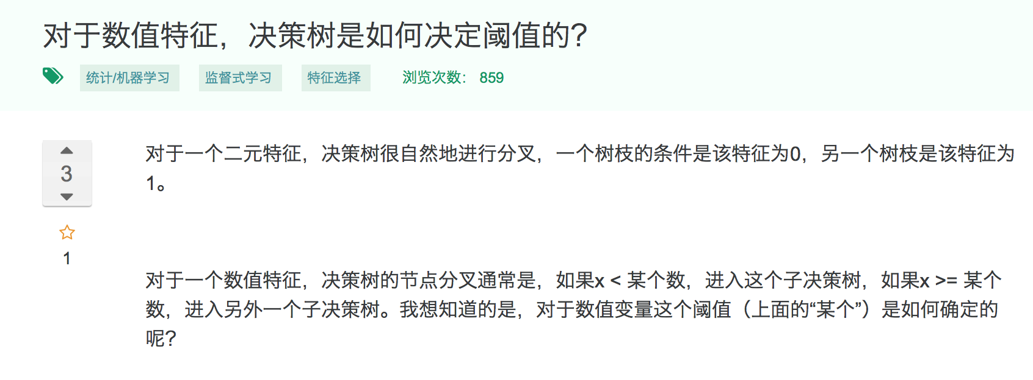
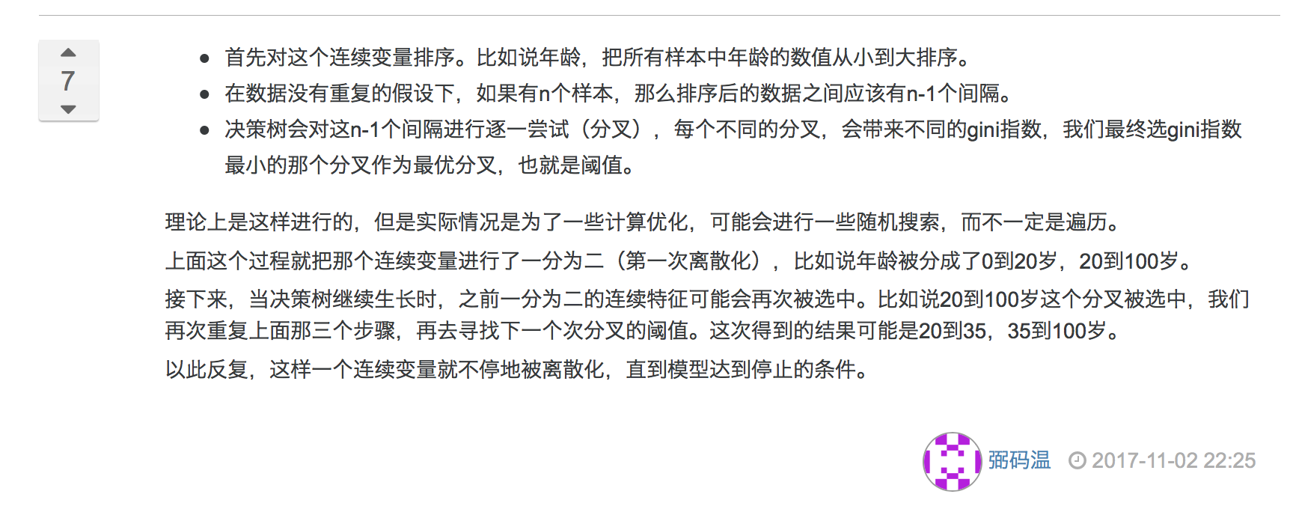
Decision Tree: 步骤和公式

Slide 51
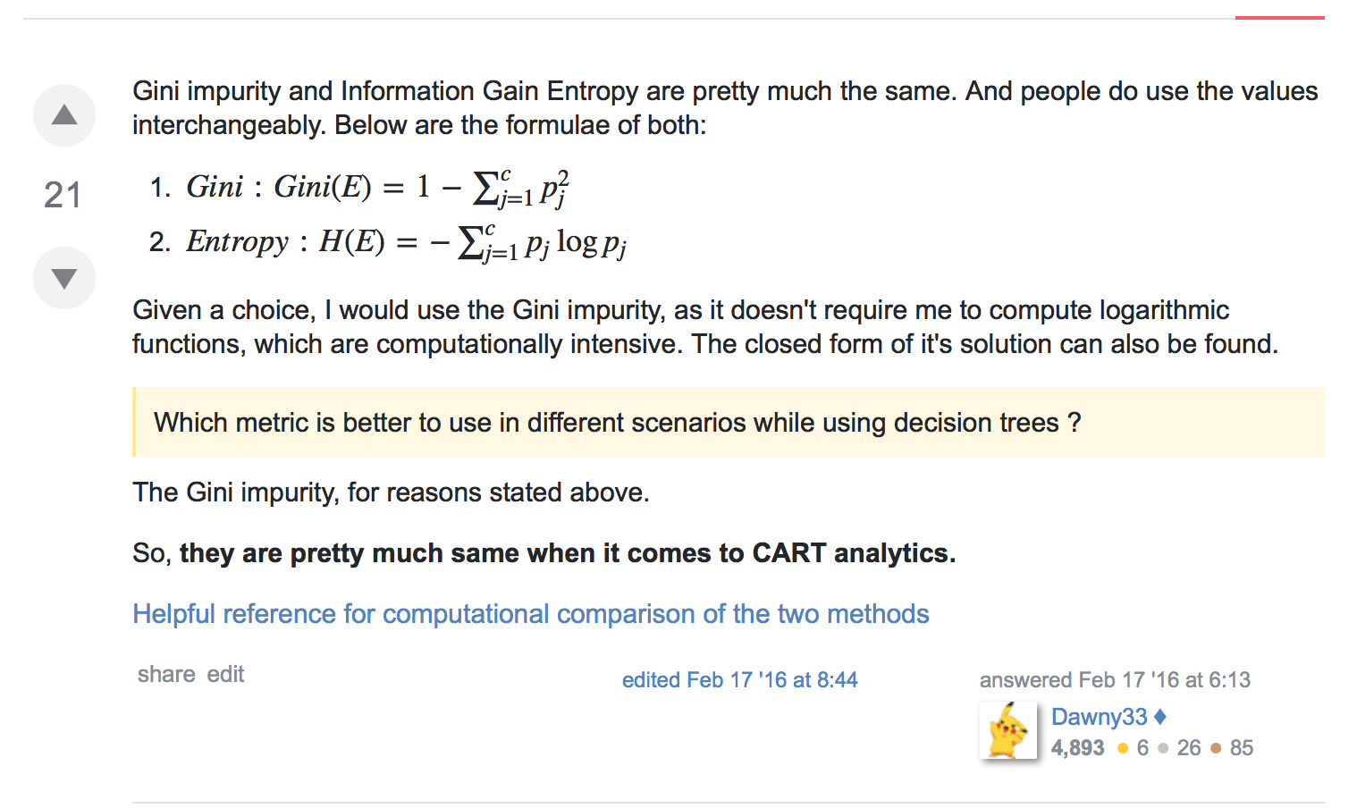
Decision Tree: 步骤和公式

Slide 52
RF: 步骤和公式

Slide 53
RF: 步骤和公式

Slide 54
GBM: 步骤和公式

Slide 55
RF vs. GBM: 步骤和公式

Slide 56


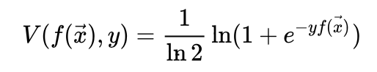
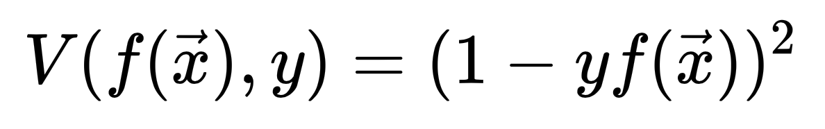
Loss function 损失函数
一般的loss term有5种 •Cross Entropy Loss
•Hinge (SVM, soft margin)
•Logistic Loss
•Squared loss (linear regression) 即平凡差
•Exponential loss (Boosting)
Notes:
http://blog.csdn.net/JIEJINQUANIL/article/details/50549006
https://en.wikipedia.org/wiki/Loss_functions_for_classification#Square_loss

Slide 57
Loss function 损失函数
•Hinge (SVM, soft margin)

Slide 58
Metrics 评估方法：
添加公式
The loss function is used to optimize your model. This is the function that will get minimized by the optimizer.
A metric is used to judge the performance of your model. This is only for you to look at and has nothing to do with the optimization process.

Slide 59
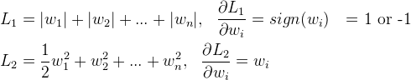
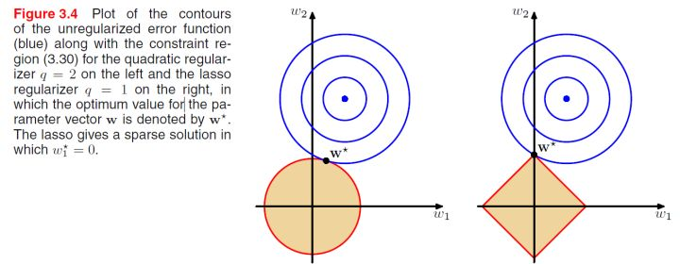
L1：(lasso正则) 计算绝对值之和，用以产生稀疏性
L2: (Euclidean, ridge正则) 计算平方和再开根号，L2范数更多是防止过拟合，并且让优化求解变得稳定很快速（这是因为加入了L2范式之后，满足了强凸）

Slide 60
两种 regularization 能不能把最优的 x 变成 0，取决于原先的费用函数在 0 点处的导数。
如果本来导数不为 0，那么施加 L2 regularization 后导数依然不为 0，最优的 x 也不会变成 0。
而施加 L1 regularization 时，只要 regularization 项的系数 C 大于原先费用函数在 0 点处的导数的绝对值，x = 0 就会变成一个极小值点。
上面只分析了一个参数 x。事实上 L1 regularization 会使得许多参数的最优值变成 0，这样模型就稀疏了。

Slide 61
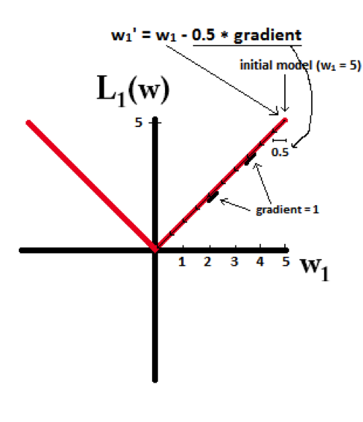
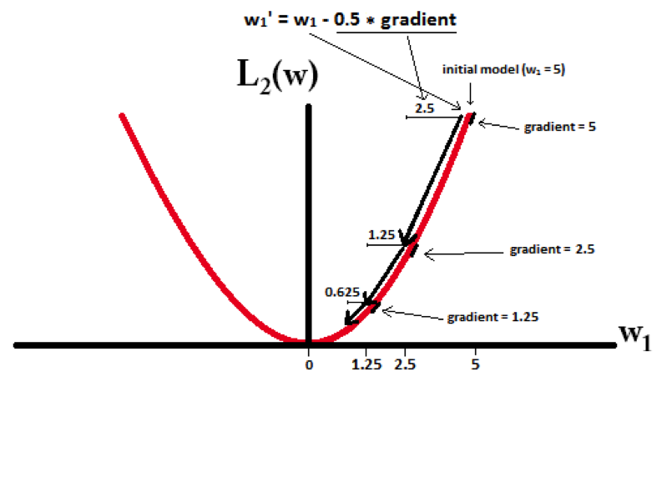
想象用梯度下降的方法，当w小于1时，L2正则项的惩罚效果越来越小， L1正则项的惩罚效果依然很大。因此， L1可以惩罚到0； 而L2很难惩罚到0

Slide 62
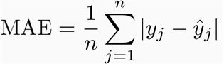
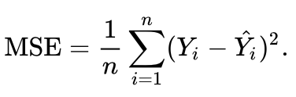
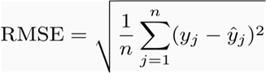
Metrics 评估方法： vs. loss function
The loss function is used to optimize your model. This is the function that will get minimized by the optimizer.
A metric is used to judge the performance of your model. This is only for you to look at and has nothing to do with the optimization process.
Classification Metrics:
Accuracy
Log Loss / Cross Entropy Loss
AUC, area under ROC, PRC
Confusion Matrix
Regression Metrics:
Mean Absolute Error
Mean Squared Error 平均方差
R^2 (coefficient of determination)
均方根差
Notes:
https://en.wikipedia.org/wiki/Coefficient_of_determination

Slide 63
All about log loss
MAE and RMSE — Which Metric is Better?
- RMSE penalize large errors (since it’s squared instead of abs)
Mean Squared Error vs. Mean Absolute Error
https://medium.com/human-in-a-machine-world/mae-and-rmse-which-metric-is-better-e60ac3bde13d
https://stats.stackexchange.com/questions/48267/mean-absolute-error-or-root-mean-squared-error
Notes:
https://medium.com/human-in-a-machine-world/mae-and-rmse-which-metric-is-better-e60ac3bde13d
https://stats.stackexchange.com/questions/48267/mean-absolute-error-or-root-mean-squared-error

Slide 64
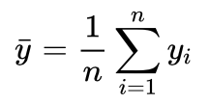
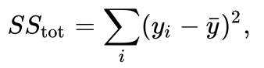
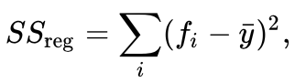
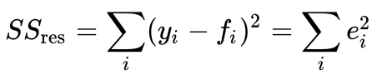
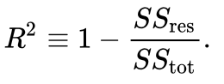
R^2 (coefficient of determination)
If y bar is the mean of the observed data:
The total sum of squares (proportional to the variance of the data):
The regression sum of squares, also called the explained sum of squares:
The sum of squares of residuals, also called the residual sum of squares:
The most general definition of the coefficient of determination is

Slide 65
Metrics 评估方法：AUC / Area under ROC Curve
 | 预测
实际 | 1 | 0 | 合计
1 | True Positive（TP） | False Negative（FN） | Actual Positive(TP+FN)
0 | False Positive（FP) | True Negative(TN) | Actual Negative(FP+TN)
 | Predicted Positive(TP+FP) | Predicted Negative(FN+TN) | TP+FP+FN+TN
(1)真正类率 TPR = TP/(TP+FN) 预测的正类中, “实际正实例” 占 “所有正实例” 的比例
sensitivity, recall, hit rate, true positive rate (TPR)
(2)负正类率 FPR = FP/(FP+TN) 预测的正类中, ”实际负实例” 占 “所有负实例” 的比例
1-Specificity, False Postive Rate
(3)真负类率 TNR = TN/(FP+TN) 预测的负类中, “实际负实例” 占 “所有负实例” 的比例
TNR=1-FPR, Specificity (True Negative Rate)
Notes:
https://en.wikipedia.org/wiki/Confusion_matrix
https://www.cnblogs.com/dlml/p/4403482.html

Slide 66
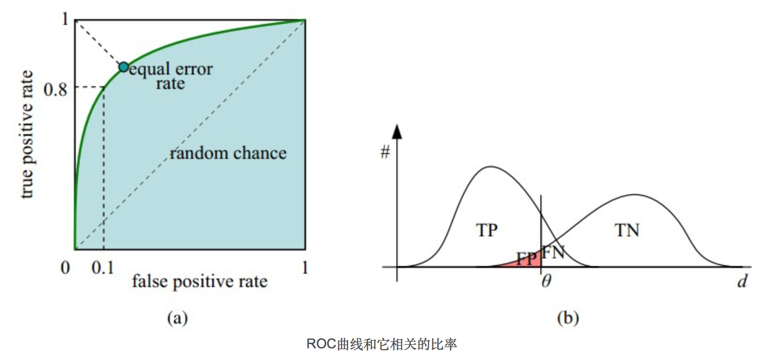
ROC 曲线：
(a)理想情况下，TPR应该接近1，FPR应该接近0。
ROC曲线上的每一个点对应于一个threshold，对于一个分类器，每个threshold下会有一个TPR和FPR。
比如Threshold最大时，TP=FP=0，对应于原点；Threshold最小时，TN=FN=0，对应于右上角的点(1,1)
(b)P和N得分不作为特征间距离d的一个函数，随着阈值theta增加，TP和FP都增加
假设采用逻辑回归分类器，其给出针对每个实例为正类的概率，那么通过设定一个阈值如0.6，概率大于等于0.6的为正类，小于0.6的为负类。对应的就可以算出一组(FPR,TPR),在平面中得到对应坐标点。随着阈值的逐渐减小，越来越多的实例被划分为正类，但是这些正类中同样也掺杂着真正的负实例，即TPR和FPR会同时增大。阈值最大时，对应坐标点为(0,0),阈值最小时，对应坐标点(1,1)。
Notes:
https://en.wikipedia.org/wiki/Confusion_matrix
https://www.cnblogs.com/dlml/p/4403482.html

Slide 67
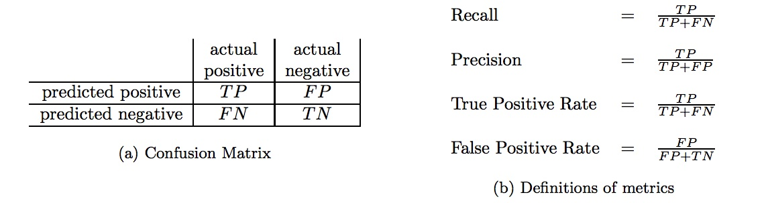
从AUC判断分类器（预测模型）优劣的标准：
AUC = 1，是完美分类器，采用这个预测模型时，存在至少一个阈值能得出完美预测。绝大多数预测的场合，不存在完美分类器。
0.5 < AUC < 1，优于随机猜测。这个分类器（模型）妥善设定阈值的话，能有预测价值。
AUC = 0.5，跟随机猜测一样（例：丢铜板），模型没有预测价值。
AUC < 0.5，比随机猜测还差；但只要总是反预测而行，就优于随机猜测。
为什么还要使用ROC和AUC呢？因为ROC曲线有个很好的特性：当测试集中的正负样本的分布变换的时候，ROC曲线能够保持不变。在实际的数据集中经常会出现样本类不平衡，即正负样本比例差距较大，而且测试数据中的正负样本也可能随着时间变化

Slide 68
Precision-Recall 曲线
精确度 precision = TP / (TP + FP)
召回率 recall = TP / (TP + FN)
下面是两个场景： 1. 地震的预测 对于地震的预测，我们希望的是RECALL非常高，也就是说每次地震我们都希望预测出来。这个时候我们可以牺牲PRECISION。情愿发出1000次警报，把10次地震都预测正确了；也不要预测100次对了8次漏了两次。 2. 嫌疑人定罪 基于不错怪一个好人的原则，对于嫌疑人的定罪我们希望是非常准确的。及时有时候放过了一些罪犯（recall低），但也是值得的。
对于分类器来说，本质上是给一个概率，此时，我们再选择一个CUTOFF点（阀值），高于这个点的判正，低于的判负。那么这个点的选择就需要结合你的具体场景去选择。反过来，场景会决定训练模型时的标准，比如第一个场景中，我们就只看RECALL=99.9999%（地震全中）时的PRECISION，其他指标就变得没有了意义。
如果只能选一个指标的话，肯定是选PRC了。可以把一个模型看的一清二楚。
宁可错杀，不可放过：低准确，高召回。
宁可放过，绝不冤枉：高准确，低召回。

Slide 69

精确度
precision = TP / (TP + FP)
召回率
recall = TP / (TP + FN)
问： 一大一小说明什么？
高 precision → FP很小
低 recall → FN很大
→ 分类器的预测偏向Negative
低 precision → FP很大
高 recall → FN很小
→ 分类器的预测偏向Positive

Slide 70
F1 score 为什么存在： Precision和Recall这两者在某些情况下有矛盾的。
需要综合考虑两者的情况下， 用f1来衡量分类器的好坏。
问：什么情况下 precision 和 recall 是矛盾的？
我们在评价的时候，当然是希望检索结果Precision越高越好，同时Recall也越高越好，但事实上这两者在某些情况下有矛盾的。
比如极端情况下，在我们这个例子中，我们只搜索出了一个结果，且是香蕉，那么Precision就是100%，但是Recall为1/6就很低；而如果我们抽取10个水果，那么比如Recall是100%，但是Precision为6/10，相对来说就会比较低。
因此P和R指标有时候会出现的矛盾的情况，这样就需要综合考虑他们，最常见的方法就是F-Measure，通过计算F值来评价一个指标！
我这里给出最常见的F1计算方法，如下：
F1 = （2*P*R）/(P+R)
F1-SCORE主要用于不平衡分类，若是正负样本比例悬殊，如正样本占了90%，这个时候若你的模型将所有样本全预测为正样本，模型的精确度任然有0.9，但显然你的模型是一个很差的模型（一个负样本都没有预测出来），反之召回率在正负样本不均衡时也会存在这个问题，此时我们利用F1-SCORE来均衡的表征模型精度。
F1-SCORE = precision*recall*2/(precision+recall)

Slide 71
Which Algo has which metric???
 | ACC | Log loss | Etc…
SVM | yes | no
RF
etc

Slide 72
Dimension Reduction:
PCA (unsupervised)
LDA (supervised)
Auto-encoder (unsupervised)
Random Projection (unsupervised): very easy
https://en.wikipedia.org/wiki/Random_projection
NMF (unsupervised)?
弄懂：原理 - 公式 – implementation
然后比较 计算速度

Slide 73
PCA vs Auto-encoder

Slide 74
Auto-encoder vs Sparse auto-encoder
There’re now thousands of researchers who’ve spent years of their lives hand-engineering vision, audio or text features.
Ideally we’d like to have algorithms that can automatically learn even better feature representations than the hand-engineered ones.
sparse autoencoder learning algorithm is one approach to automatically learn features from unlabeled data.
AE: To discover interesting structure/pattern when # of hidden units is small.
Sparse AE: Even if # of hidden units is large, we can still discover interesting structure in the data
by imposing a sparsity constraint on the hidden units.

Slide 75


Slide 76



Slide 77
WHAT THE FUCK is KL divergence??

Slide 78
KL divergence and Cross entropy 关系????

Slide 79

Logit is a function that maps probabilities ([0, 1]) to R ((-inf, inf))
Probability of 0.5 corresponds to a logit of 0. Negative logit correspond to probabilities less than 0.5, positive to > 0.5.
Logit is a function that maps probabilities [0, 1] to [-inf, +inf].
Softmax ( normalized exponential function) is a function that maps [-inf, +inf] to [0, 1] similar as Sigmoid. But Softmax also normalizes the sum of the values(output vector) to be 1.
Tensorflow "with logit": It means that you are applying a softmax function to logit numbers to normalize it. The input_vector/logit is not normalized and can scale from [-inf, inf].
This normalization is used for multiclass classification problems. And for multilabel classification problems sigmoid normalization is used i.e. tf.nn.sigmoid_cross_entropy_with_logits
Notes:
https://stackoverflow.com/questions/41455101/what-is-the-meaning-of-the-word-logits-in-tensorflow

Slide 80



Softmax ( normalized exponential function) vs. Sigmoid function

Slide 81



Slide 82
In Tensorflow:
What is an epoch?
What is a step?
A training step is one gradient update. In one step batch_size many examples are processed.
An epoch consists of one full cycle through the training data. This is usually many steps.
As an example, if you have 2,000 images and use a batch size of 10, an epoch consists of 2,000 images / (10 images / step) = 200 steps.
Gradient Descent vs. Stochastic Gradient Descent
Pros vs. cons
Notes:
https://stackoverflow.com/questions/49782346/in-tensorflow-estimator-class-what-does-it-mean-to-train-one-step/49790837?noredirect=1#comment86637217_49790837

Slide 83
Tensorflow
Dense layer: A linear operation in which every input is connected to every output by a weight (so there are n_inputs * n_outputs weights - which can be a lot!). Generally followed by a non-linear activation function
Convolutional layer: A linear operation using a subset of the weights of a dense layer. Nearby inputs are connected to nearby outputs (specifically - a convolution173 ). The weights for the convolutions at each location are shared. Due to the weight sharing, and the use of a subset of the weights of a dense layer, there’s far less weights than in a dense layer. Generally followed by a non-linear activation function
Pooling layer: Replace each patch in the input with a single output, which is the maximum (can also be average) of the input patch
Normalization layer: Scale the input so that the output has near to a zero mean and unit standard deviation, to allow for faster and more resilient training

Slide 84
what is overfitting? can you explain overfitting? can you give me a definition?? How do you detect overfitting? what is a signal that overfitting is happening?
Choose one regularization (L1, L2, …) and explain in detail how it works??
punishment factor???? LOL where does it kick in?
gradient descend - explain how it works step by step. Do we subtract the stepszie*gradient from the xyz parameters or do we add stepszie*gradient????

Slide 85
why is underfitting high bias and overfitting high variance?
Is bias the same as underfitting and variance the same as overfitting?
They do not exactly mean the same thing, but they are correlated in the following manner:
Over fitting occurs when the model captures the noise and the outliers in the data along with the underlying pattern. These models usually have high variance and low bias. These models are usually complex like Decision Trees, SVM or Neural Networks which are prone to over fitting.
Under fitting occurs when the model is unable to capture the underlying pattern of the data. These models usually have a low variance and a high bias. These models are usually simple which are unable to capture the complex patterns in the data like Linear and Logistic Regressions.

Slide 86


Slide 87

Latent Dirichlet Allocation (LDA): What is the best way to determine number of topics?
Topic coherence is a realistic measure of how good the topics produced by LDA really are.
You can built multiple models and compute the coherence scores for different number of topics. The model with the best topic coherence wins.
Notes:
https://www.machinelearningplus.com/nlp/topic-modeling-gensim-python/#17howtofindtheoptimalnumberoftopicsforlda
http://qpleple.com/topic-coherence-to-evaluate-topic-models/

Slide 88

Latent Dirichlet Allocation (LDA): What is the best way to determine number of topics?
http://qpleple.com/topic-coherence-to-evaluate-topic-models/

Slide 89


Latent Dirichlet Allocation (LDA): What is the best way to determine number of topics?

Slide 90

Latent Dirichlet Allocation (LDA): What is the best way to determine number of topics?

Slide 91

Latent Dirichlet Allocation (LDA): What is the best way to determine number of topics?

Slide 92
P-value and Confidence Interval
标准正态分布下，约95.5% 样本落在 +/-2 sigma区间内。而p=0.05自身意味着样本统计有95%的信心拒绝原假设 (无效假设：null hypothesis).
P值 | 碰巧的概率 | 对无效假设 | 统计意义
P>0.05 | 碰巧出现的可能性大于5% | 不能否定无效假设 | 两组差别无显著意义
P<0.05 | 碰巧出现的可能性小于5% | 可以否定无效假设 | 两组差别有显著意义
P <0.01 | 碰巧出现的可能性小于1% | 可以否定无效假设 | 两者差别有非常显著意义
P值的使用实例
实验考察一枚硬币是否均已。：
P：硬币是均匀的。
Q：在100次投掷中，得到90次正面，10次反面。
先说我们想证明什么？显然想证明硬币不均匀，把想证明的当作Ha，想证明的反面当作h0
在h0情况下得到Q（或者比Q更极端）的概率就是p-values，显然p-value越小，说明h0越“不靠谱”，也就是其反面ha（这里就是硬币不均匀）“相对更靠谱”。
所以p-value检验。思路上更类似“反证法”，但是不是严格逻辑反证，而是概率层面上的反证。通过假设出我们需要证明目标反面的情况。然后从情况推导出"出现最终观察现象"的概率非常低（5%）。就认为我们假设出的那个“证明目标反面的情况”不靠谱。从而证明“证明目标”是ok的。
P-value: 碰(Peng)巧的概率
In technical terms, a P value is the probability of obtaining an effect at least as extreme as the one in your sample data, assuming the truth of the null hypothesis.

Slide 93


Slide 94
The confidence interval is a range of values calculated by statistical methods which includes the desired true parameter (for example, the arithmetic mean, the difference between two means, the odds ratio etc.) with a probability defined in advance (coverage probability, confidence probability, or confidence level). The confidence level of 95% is usually selected. This means that the confidence interval covers the true value in 95 out of 100 studies performed. The advantage of confidence limits in comparison with p-values is that they reflect the results at the level of data measurement
Just as there is a common misconception of how to interpret P values, there’s a common misconception of how to interpret confidence intervals. In this case, the confidence level is not the probability that a specific confidence interval contains the population parameter.
The confidence level represents the theoretical ability of the analysis to produce accurate intervals if you are able to assess many intervals and you know the value of the population parameter. For a specific confidence interval from one study, the interval either contains the population value or it does not—there’s no room for probabilities other than 0 or 1. And you can't choose between these two possibilities because you don’t know the value of the population parameter.
"The parameter is an unknown constant and no probability statement concerning its value may be made."
—Jerzy Neyman, original developer of confidence intervals.

Slide 95



Slide 96
A 95% confidence interval does not mean that for a given realized interval there is a 95% probability that the population parameter lies within the interval (i.e., a 95% probability that the interval covers the population parameter). Once an experiment is done and an interval calculated, this interval either covers the parameter value or it does not; it is no longer a matter of probability. The 95% probability relates to the reliability of the estimation procedure, not to a specific calculated interval.
Neyman himself (the original proponent of confidence intervals) made this point in his original paper:
"It will be noticed that in the above description, the probability statements refer to the problems of estimation with which the statistician will be concerned in the future. In fact, I have repeatedly stated that the frequency of correct results will tend to α. Consider now the case when a sample is already drawn, and the calculations have given [particular limits]. Can we say that in this particular case the probability of the true value [falling between these limits] is equal to α? The answer is obviously in the negative. The parameter is an unknown constant, and no probability statement concerning its value may be made..."
A 95% confidence interval does not mean that 95% of the sample data lie within the interval.
A confidence interval is not a definitive range of plausible values for the sample parameter, though it may be understood as an estimate of plausible values for the population parameter.
A particular confidence interval of 95% calculated from an experiment does not mean that there is a 95% probability of a sample parameter from a repeat of the experiment falling within this interval.

Slide 97


Slide 99
Fast Hartley Transform

Slide 100
Linear Predictive Coding

Slide 101
Linear Predictive Coding
Formant

